Slide 1

Data science laboratory (DSLAB)
SG0217 iMac account
username: ee490std
password: Lid$-2018
Olivier Verscheure
Swiss Data Science Center
EPFL & ETH Zurich
Data Science Lab – Spring 2018

Slide 2







Introducing your team of instructors
Eric Bouillet
Module 2
Weeks 5 & 6
Rok Roksar
Module 3
Weeks 7, 8 & 9
Dorina Thanou
Module 1
Week 4
Julien Eberle
Modules 1 & 4
Weeks 3, 10 & 11
Sofiane Sarni
Module 4
Weeks 10 & 11
Johann Thiebaut
Module 2
Weeks 5 & 6
Jiri Kuncar
Olivier Verscheure
Module 1
Weeks 1 & 2
Sandra Savchenko-De Jong
Izabela Moise

Slide 3

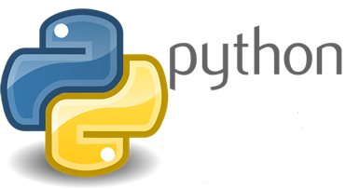



Instant Quiz
Python & Anaconda
Jupyter Notebooks
Git(Lab/Hub)
Docker containers
Kaggle

Slide 4
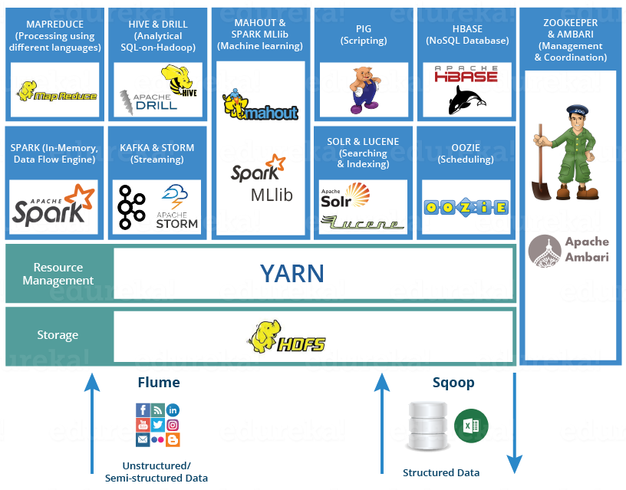
Instant Quiz
Python & Anaconda
Jupyter Notebooks
Git(Lab/Hub)
Docker containers
Kaggle
HDFS, YARN, Hive
Zookeeper, Ambari
Spark (Streaming)

Slide 5
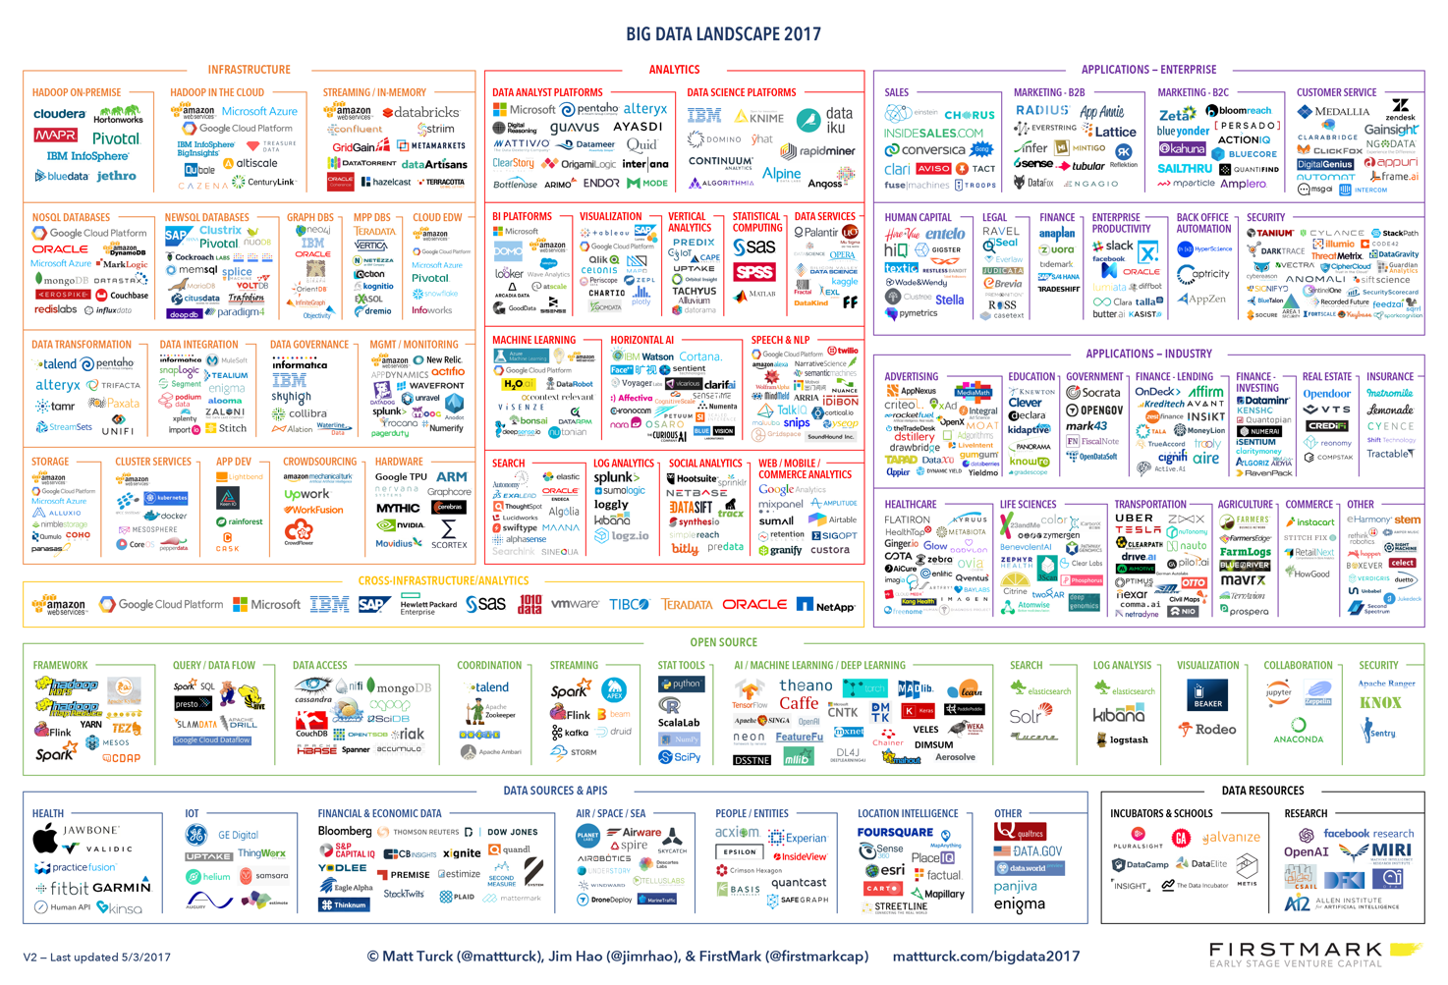
Data Science Landscape 2017

Slide 6
Outline
A sobering introduction to data science
An overview of our DSLab
This week’s lab
Configure & run Oracle VM VirtualBox
Download, configure & start our DSLab VM
Crash course of Python 3 in Jupyter Notebook

Slide 7
A sobering introduction to data science

Slide 8


About me
Academia
Industry
New York
1999
17y
2016
2010
Dublin

Slide 9
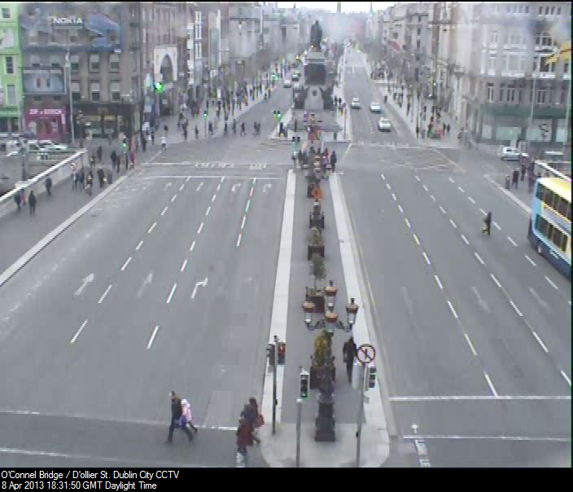
What Do You See?
Notes:
Make the world your lab

Slide 10
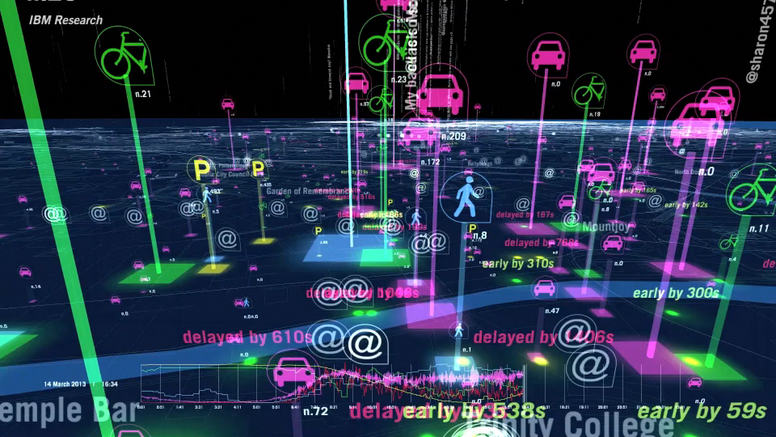
Dublin City Data Hub
Notes:
All this data emanating from the city... People tweeting, public transport vehicles reporting their positions every 20 seconds, thousand’s of loop detectors reporting on traffic volume throughout the city, car parks and bike parks reporting the number of available car or bike slots.
10

Slide 11
Data is the New Oil
The Economist, May 2017

Slide 12
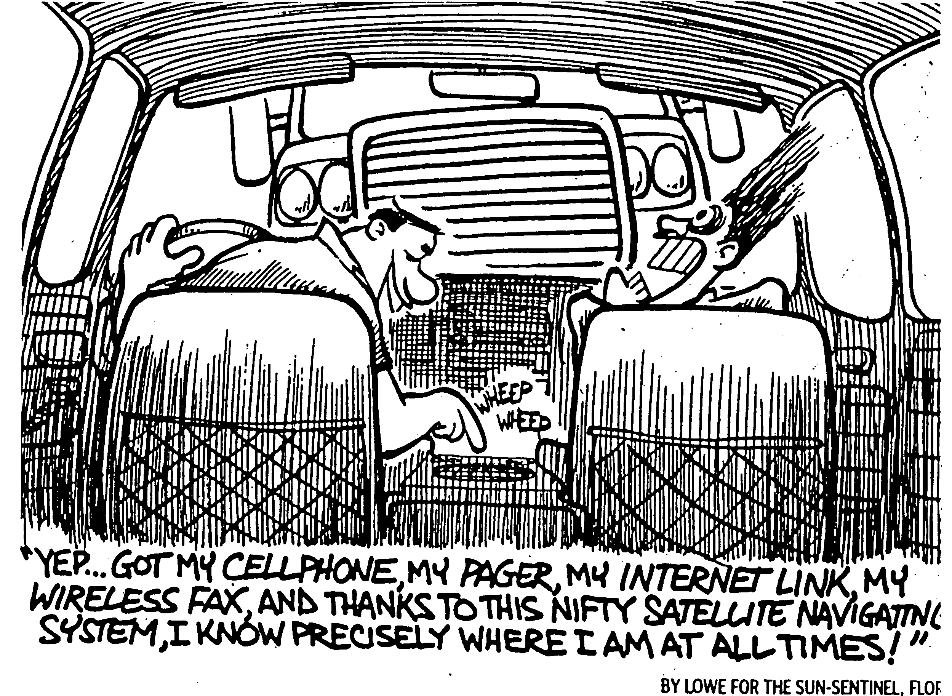
Big Data, Bad Data
Notes:
Like oil, data must be refined to have any value. Need for data refineries.

Slide 13
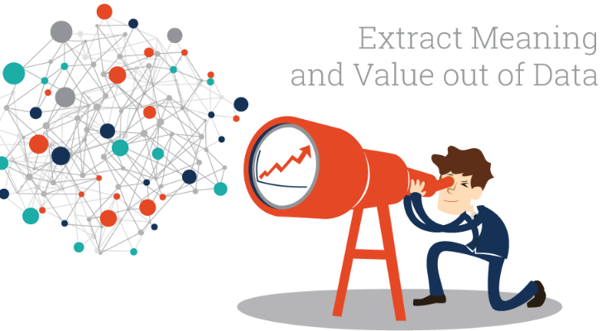

Data Science, a Fragmented Ecosystem
Data mining
DOMAIN
EXPERTS
Algorithms
Statistics
Personalized health
Smart cities
Environmental sciences
Material sciences
Social sciences
Economics
Digital humanities
DATA
SCIENCE
Data
management
GAP
Machine learning
Visual analytics
Operations research
How can I best match the right drug with the right dosage to the right patient at the right time?
Visualization
What is the hyperplane that best separates two classes of points in multidimensional space?

Slide 14

A Sobering View of Data Science

Slide 15
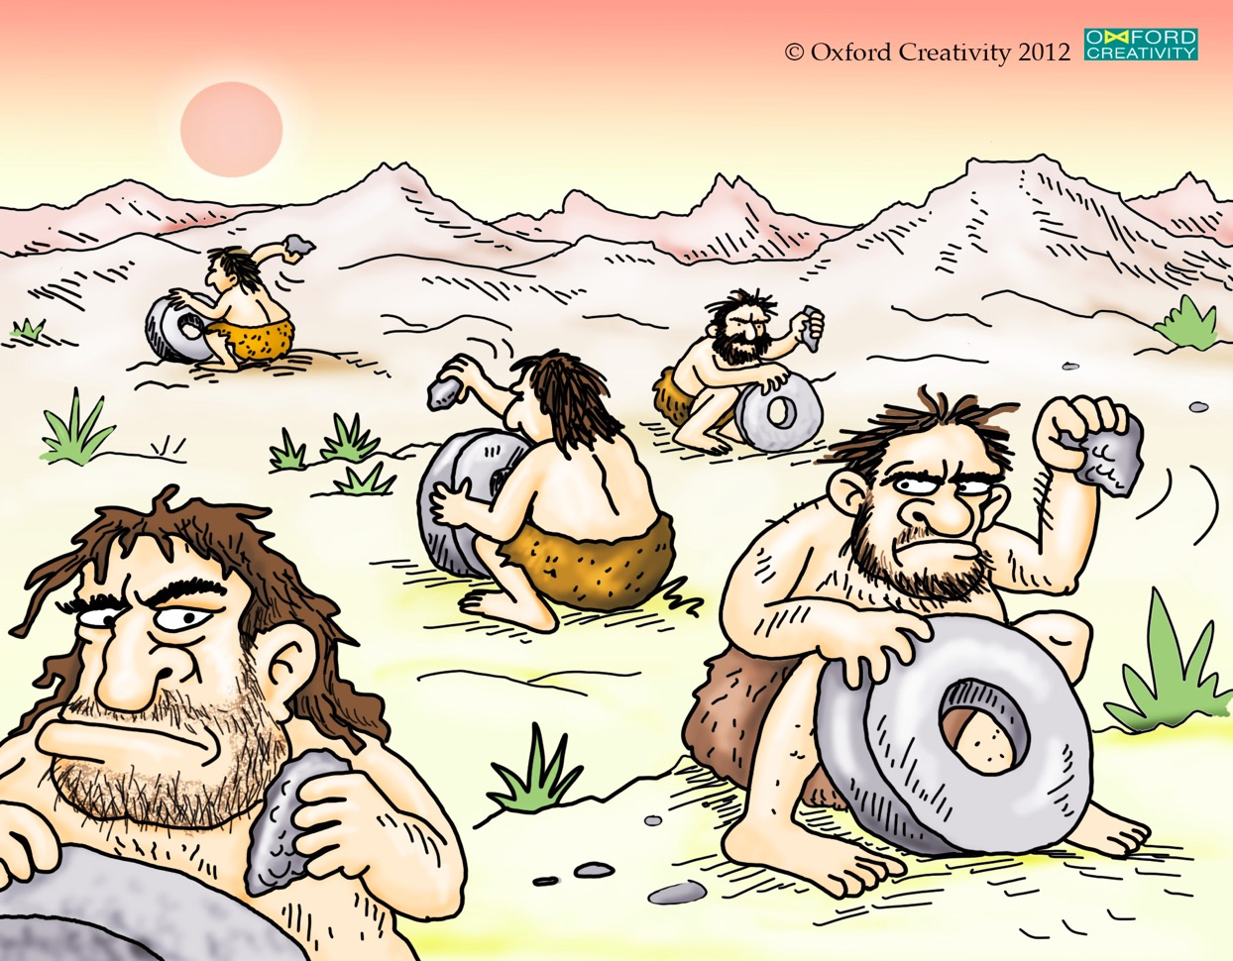
Other Roadblocks in Data Science
credit: oxford creativity, https://www.triz.co.uk/
Notes:
Growing disconnect between actors in data science ventures
Work in silos, unaware of insights generated by others
Communication barriers, among humans & machines
R&D not always traceable / verifiable
Data and methods often not reusable
Scientific progress hampered by frequent re-inventions of the wheel

Slide 16
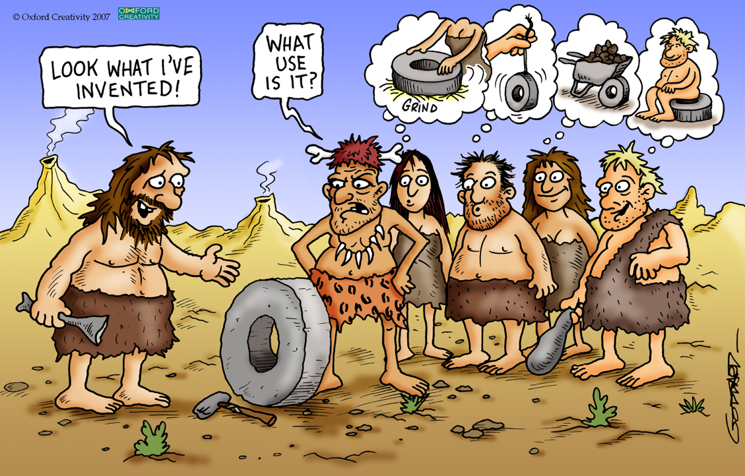
Facilitate communication to foster innovation
credit: oxford creativity, https://www.triz.co.uk/

Slide 17
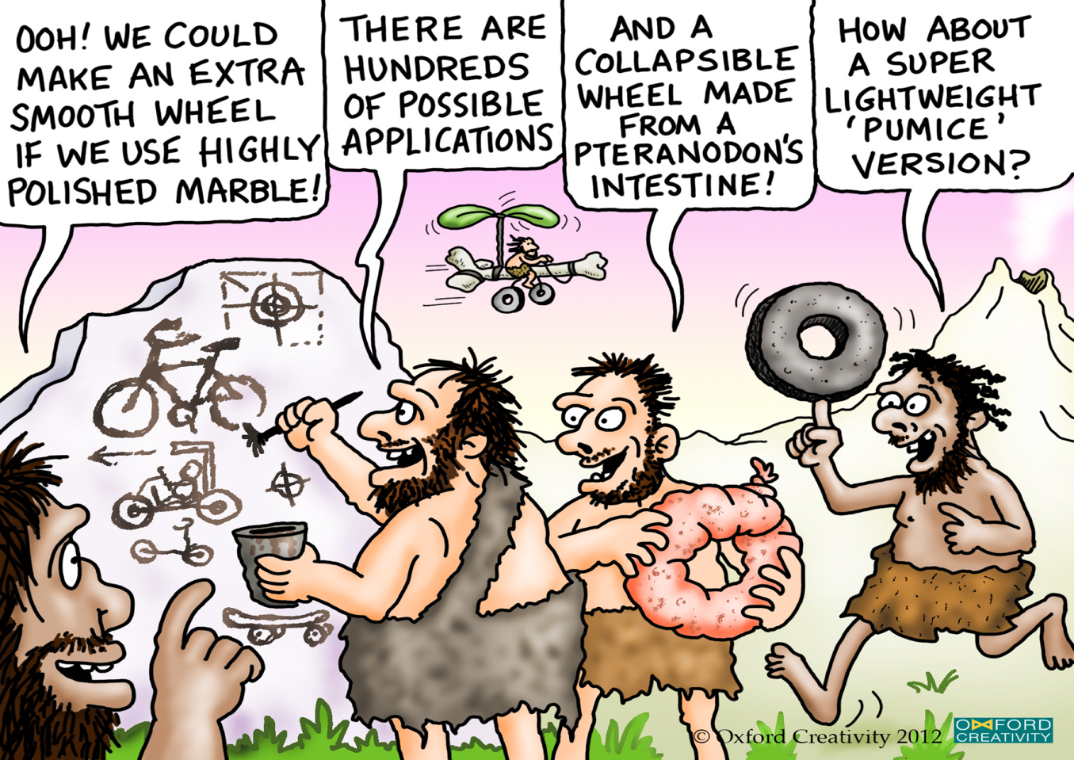
Encourage multidisciplinary collaborations
credit: oxford creativity, https://www.triz.co.uk/

Slide 18


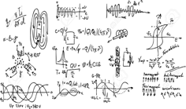
Swiss Data Science Center (SDSC)
Foster adoption of data science both in academia and industry
Multi-disciplinary team of 40 full-time computer and data
scientists, and domain experts
How can I best match the right drug with the right dosage to the right patient at the right time?
+
Domain experts
What is the hyperplane that best separates two classes of points in multidimensional space?
How is my data protected?
How private is it?
How exactly is it used?
Data scientists
Data providers
Notes:
federate data providers, data and computer scientists, and subject-matter experts
foster scientific breakthroughs with significant societal impact.

Slide 19
Key Actor in a Complex Ecosystem
Domain expertise
Environmental
Sciences
Personalized
Health
Manufacturing intelligence
Predictive maintenance
Swiss Data Science Center
Applied
Research
Basic Research in
Data science
Smart sensing
Data security
& privacy
Statistics
Machine learning
Operations
research
Visualization
Notes:
Each academic discipline could be associated to labs on the ETH Domain
Now, along the other dimension… from basic research in data science to… domain science where domain expertise lies
There is a gap. If you want to solve a real problem in one of the domains, things can get tricky. Especially because many real-world problems in data science are multidisciplinary by nature, and that labs focus deep on a specific academic discipline.
With this rather large definition of data science, about 100 labs from the ETH Domain are active in data science

Slide 20
An overview of our dslab

Slide 21

Five Modules in 14 weeks
Crash-course in Python for data scientists (4 weeks)
Distributed computing with a Hadoop Distribution (2 weeks)
Distributed processing with Apache Spark (3 weeks)
Real-time data acquisition and processing (2 weeks)
Final project (3 weeks)
Data science as a journey!
Very hands-on and practical
3+ instructors for every lab
credit: oxford creativity, https://www.triz.co.uk/

Slide 22
Assessment
60% continuous assessment during the semester
One project per module (last week)
Groups of 2 students
Projects graded within one week
40% final project
3-week project in the classroom
Choice of 3 projects
Groups of 2-3 students
credit: oxford creativity, https://www.triz.co.uk/

Slide 23
Hardware / Software Resources
(56+1) iMac 27-inch i7 4 GHz, 16 GB
Please bring your own laptop!
Oracle VirtualBox (virtualization software)
DSLab VM image (virtual image - VM)
HDP Sandbox (virtual image - VM)
Hadoop Cluster
credit: oxford creativity, https://www.triz.co.uk/
Notes:
HDP: HortonWorks Data Platform

Slide 24
Module 1: Crash-course in Python for data scientists
Week #1
Jupyter Notebooks
Python 3.x
Week #2
NumPy, Pandas, Matplotlib, Scikit-Learn
Week #3
Git, Docker, Kaggle
Week #4
Assessed project
Outlier detection in CO2 signals from geolocalized sensors
Week 3
Week 4
Weeks 1 & 2
credit: oxford creativity, https://www.triz.co.uk/
Notes:
HDP: HortonWorks Data Platform

Slide 25
Module 2: Distributed computing with Hadoop
Week #5
Overview bundled components
Configuration best practices & guidelines
Week #6
Loading & querying data with Hadoop
Assessed project
Scaling up to Hadoop cluster
Weeks 5 & 6
Weeks 5 & 6
credit: oxford creativity, https://www.triz.co.uk/

Slide 26
Module 3: Distributed processing with Apache Spark
Weeks #7
Introduction to distributed computing and the Spark runtime architecture
Learn Python features needed for efficient Spark
Use basic RDD manipulations to construct an N-gram viewer of the Gutenberg book corpus
Bonus: learn to transform data to use the Spark machine learning library
Week #8
Finish project from past week
Spark DataFrames
Week #9
Assessed project
Use DataFrames for mining a Twitter archive
Weeks 7, 8 & 9
credit: oxford creativity, https://www.triz.co.uk/
Notes:
Resilient Distributed Datasets (RDD) is a fundamental data structure of Spark.

Slide 27
Module 4: Real-time data acquisition and processing
Week #10
Overview of MQTT as sensor protocol
Apache NiFi for IoT data collection
Apache Kafka for stream processing
Week #11
Assessed project
Process streaming data from remote Raspberry Pi sensor
Weeks 10 & 11
Weeks 10 & 11
credit: oxford creativity, https://www.triz.co.uk/
Notes:
s

Slide 28
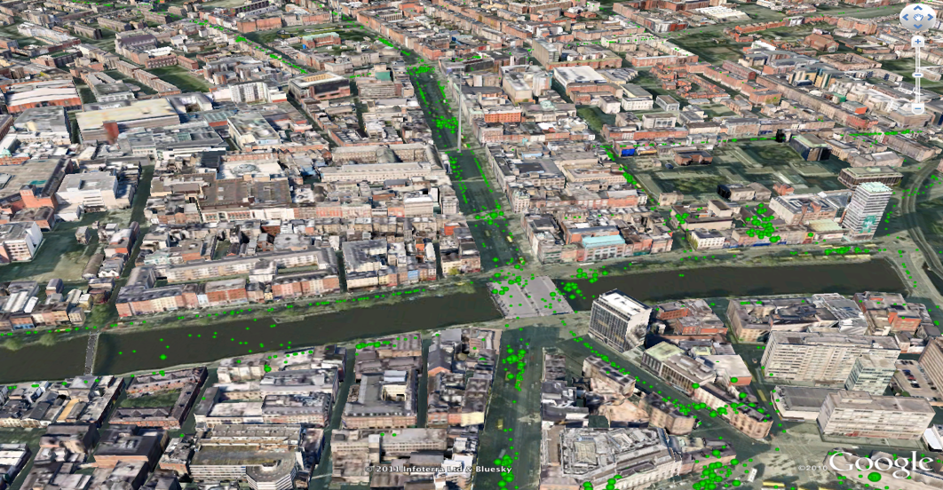
Module 5: Real-time data acquisition and processing
Weeks #12 - #14
Choice of 3 projects in mobility
Live data from Dublin City
Historical data from Switzerland
credit: oxford creativity, https://www.triz.co.uk/
Notes:
s

Slide 29
Today’s lab week #1 overview jupyter notebook crash course Python 3.x

Slide 30
Start your engines!
Head over to the course webpage
https://dslab2018.github.io/
Configure & Run Oracle VirtualBox
Download, configure & start the DSLab VM
Ubuntu linux
Anaconda (Python 3), git, Docker, Spark / pySpark, pyCharm
{username: student, password: student}
Open a terminal
Run: ~ jupyter notebook
Notes:
pySpark: Spark Python API

Slide 31
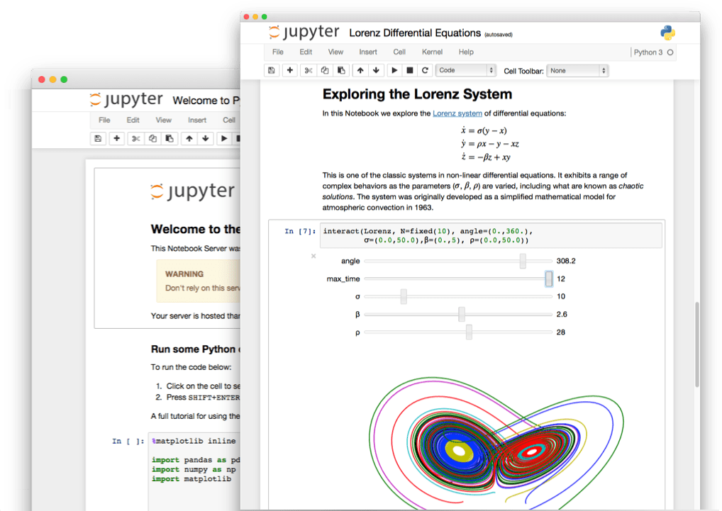
Overview of jupyter notebook

Slide 32
What is a Jupyter notebook?
Open source web application
Development started in 2014 as spin-off from IPython
Notebooks denotes documents that contain both
Code, and rich text elements (figures, links, equations, etc)
Notebook documents produced by the Jupyter Notebook App
Client-server application to edit and run notebooks
Two main components: the kernels and a dashboard
Jupyter is a loose acronym meaning Julia, Python and R
Nowadays, Jupyter supports many other languages
Notes:
You could basically do many different things with a notebook… but it is heavily used these days to
Show a simple example:
a = 2
b = 3
Let’s compute $c = a^2 + b^2$
c = a**2 + b**2
print(c)
# & show \sqrt{.} in Latex
Show how to insert an image in a Markdown Cell
Show how to insert HTML (eg <H2>…</H2>) - %%HTML
Show how to time block of code (cell) - %%timeit x = range(10000) max(x)

Slide 33
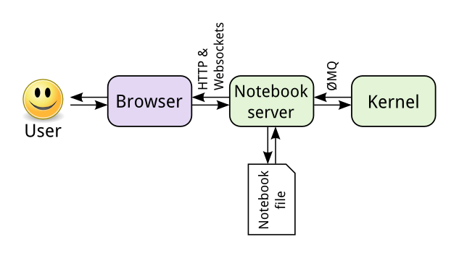
Jupyter is language-agnostic
The notebook server is responsible for saving and loading notebooks
The notebook is saved as a JSON file
The kernel gets sent cells of code to execute
Notes:
When you save a notebook, this is sent from your browser to the notebook server, which saves it on disk as a JSON file with a .ipynb extension.
JSON (JavaScript Object Notation) is a language-independent, human-readable open-standard file format (attribute-value pairs). It was derived from JavaScript.
The kernel doesn’t know anything about the notebook document: it just gets sent cells of code to execute when the user runs them.
** Show command lines as I create two new notebooks
** Explain that, as discussed before, we could install more kernels

Slide 34
Setting up a Python 2 kernel
We are running Jupyter on Python 3
Let’s set up a Python 2 kernel using conda
~ conda create -n ipykernel_py2 python=2 ipykernel
~ source activate ipykernel_py2
~ python -m ipykernel install --user
Notes:
Edit ~/.local/share/jupyter/kernels/python2/kernel.json
-> Python 2 => Old Python
Rerun the %%timeit example

Slide 35
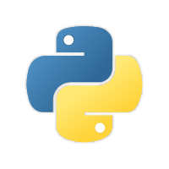
Crash course in Python 3.x

Slide 36
Brief history of Python
Open source programming language
Conceived in the Netherlands by Guido van Rossum
Implementation started in December 1989
Python 2.x is legacy, Python 3.x is the present & future of the language
Python 2.0 released on October 16, 2000 (current: 2.7.14)
Python 3.0 released on December 3, 2008 (current: 3.6.4)
High-level, portable, interpreted, object-oriented
Notes:
2.7: 2010
3.6: late 2016
Guido van Rossum (the original creator of the Python language) decided to clean up Python 2.x properly, with less regard for backwards compatibility than is the case for new releases in the 2.x range. The most drastic improvement is the better Unicode support (with all text strings being Unicode by default) as well as saner bytes/Unicode separation.

Slide 37
Why Python?
Easy, Fast & Broad
Python Has a Healthy, Active and Supportive Community
Plenty of documentation, guides, tutorials and more
Incredibly active developer community
Python Has Some Great Corporate Sponsors
Google!
Python has Extensive Libraries
Notes:
C# has Microsoft
Java had Sun
PHP is used by Facebook
Google adopted Python heavily back in 2006

Slide 38
Python 3.x references
https://docs.python.org/3.6/tutorial/
Books include:
Learning Python by Mark Lutz
Python Essential Reference by David Beazley
Python for Data Analysis by William McKinney
https://github.com/justmarkham/DAT8#python-resources
Python Quick Reference
https://github.com/justmarkham/python-reference

Slide 39
Common pitfalls in Python
Incorrect indentation, tabs and spaces
Never use tabs, only spaces (4)
Using a mutable value as a default value
Scoping (local vs global variable)
Copying vs referencing (mutable types)
Notes:
def foo(param=None):
if param is None:
param = []
param.append(9)
return(param)
=====
bar = 42
def foo():
bar = 0 # !! bar = bar + 0 => local variable 'bar' referenced before assignment
# return(bar)
# bar = foo()
foo()
print(bar)
=====
b = a[:] same as b = a.copy()
=====

Slide 40
A few exercises in Python
Download the DSLab Week 1 Jupyter notebook
https://dslab2018.github.io/DSLab_week1_CCPython.ipynb
Generators
List comprehension
Lambda Operator and the functions map() and reduce()
Lists of characters and the functions join() and append()

Slide 41
Thank you!
http://www.datascience.ch
Twitter: @SDSCdatascience

Slide 42
Next week: Python libraries for (aspiring) data scientists
NumPy: Work with large multidimensional arrays and matrices
Matplotlib: Make line graphs, pie charts, histograms, etc
Scikit-learn: Build machine learning models
Pandas: Do data wrangling
Notes:
Scikit-learn built on top of Sci-pi

